Slide 1
Proteins and Amino Acids

Slide 2
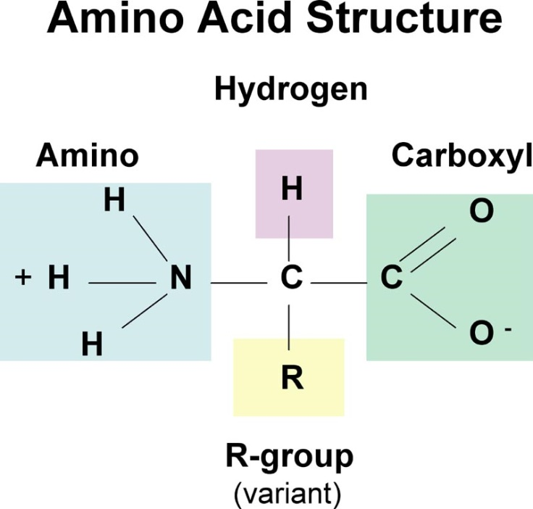
Amino Acids
Amino acids contain both –NH₂ and –COOH functional groups.
Amino acids have a two-carbon bond.
One of the carbons is part of a group called the carboxyl group (COO⁻). Always present ate the terminal.
That carboxyl group has a negative charge, since it is a carboxylic acid (-COOH) that has lost its hydrogen (H) atom. What is left — the carboxyl group — is called a conjugate base.
The second carbon is connected to the amino group. NH₂ . In the image, you see a "+" and a "-".
Those positive and negative signs are there because, in amino acids, one hydrogen atom moves to the other end of the molecule. An extra "H" gives a positive charge.

Slide 3
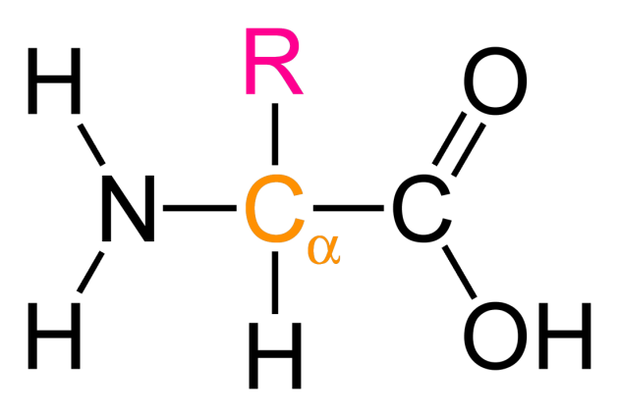
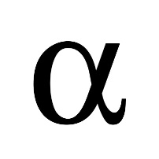
Amino acid
Amine and carboxylic group both are present on the same C-atom.
They are the building blocks of proteins.
20 amino acids are commonly found in proteins.
The 11 amino acids that the human body makes are called non-essential amino acids.
The 9 amino acids that the human body needs but cannot make are called essential amino acids. These must be eaten.

Slide 4
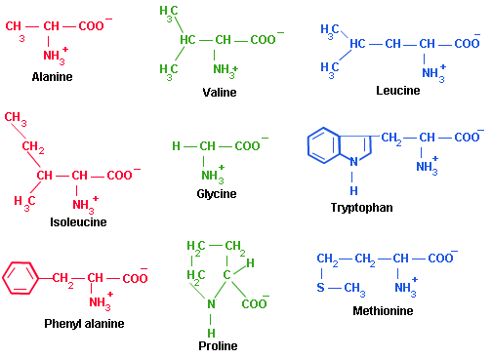
Examples of Amino acids

Slide 5
Amino acids contd.
Amine groups are basic (proton acceptor), carboxylic acid groups are acidic (proton donator).
Amino acids are both amphiprotic (can accept or donate protons) and amphoteric (can react with acids or bases).
The amino acids are crystalline solids with surprisingly high melting points.

Slide 6
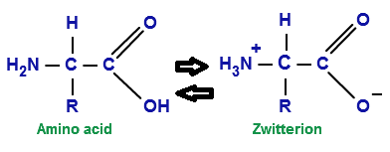
Zwitterion
A zwitterion is the representation of the dipolar amino acid.
A zwitterion is a compound with no overall electrical charge, but which contains separate parts which are positively and negatively charged.
Amino acids in solution exist as an equilibrium mixture of neutral molecules and dipolar ions called zwitterions:

Slide 7

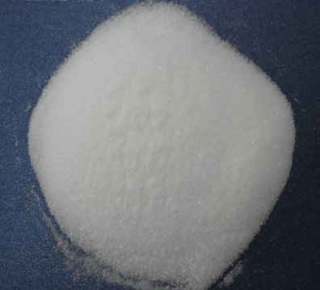
Why are amino acids solids
Amino acids are crystalline solids with high melting points.
In solid state zwitterions are attracted to one another by much stronger ionic interactions.
They are soluble in water because zwitterion is a dipolar species.

Slide 8
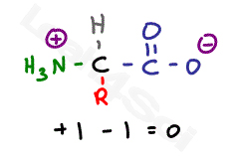
Isoelectric point
The word isoelectric or isoelectronic comes from ‘iso,’ which means the same, and ‘electric,’ which implies charge. The isoelectric point or pI of an amino acid is the pH at which an amino acid has a net charge of zero.
That means neutral zwitterion dominates.

Slide 9
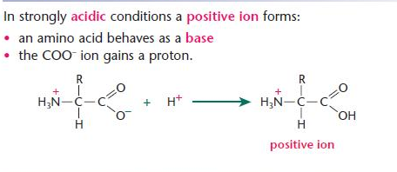
Shifting the pH- Acidic medium
In acid solution the zwitterion converts to a positively charged ion:

Slide 10
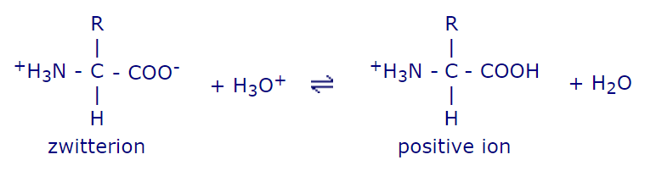
Shifting the ph
By Le Chatelier's Principle, the more acidic the solution, the more positive ions will be formed.

Slide 11
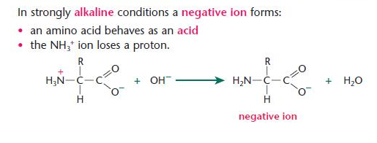
Shifting the pH- Basic medium

Slide 12
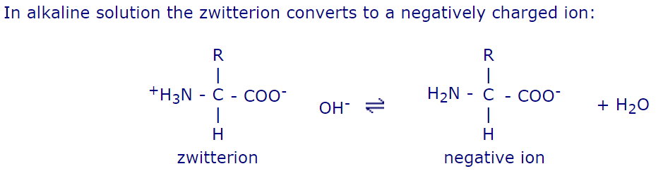
Shifting the pH- Basic medium

Slide 13
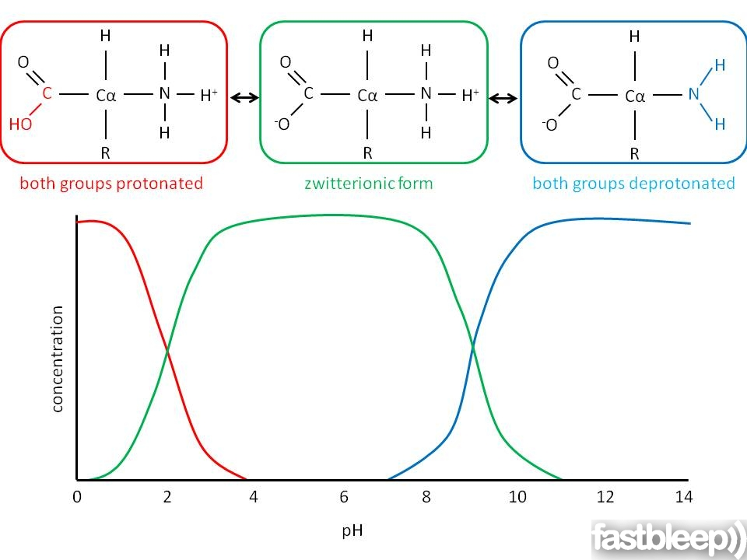

Slide 14
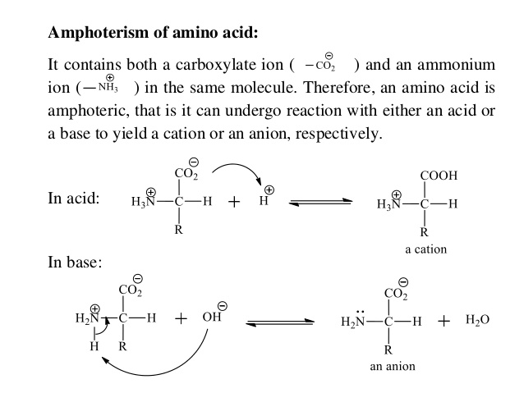

Slide 15
Properties of amino acids
The property of alpha amino acids determines the properties of proteins they make.
The properties of Carbon chain(R) attached to the alpha carbon determines the properties of alpha amino acids.
The main properties of amino acids are
acid/basic(proton donor/acceptor) nature of alpha amino acid
Polarity of amino acid(polarity is linked to its solubility in water)

Slide 16
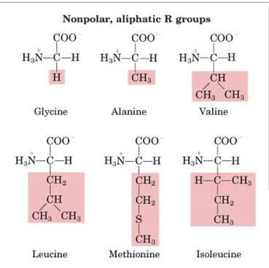
CASE 1
R is hydrocarbon, neutral and Non polar

Slide 17
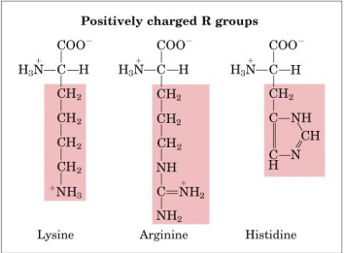
CASE 2
R has amine group at the end, Basic and Polar

Slide 18
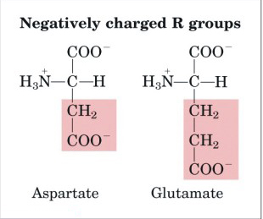
CASE 3
R has a carboxylic group at the end, Acidic and Polar

Slide 19
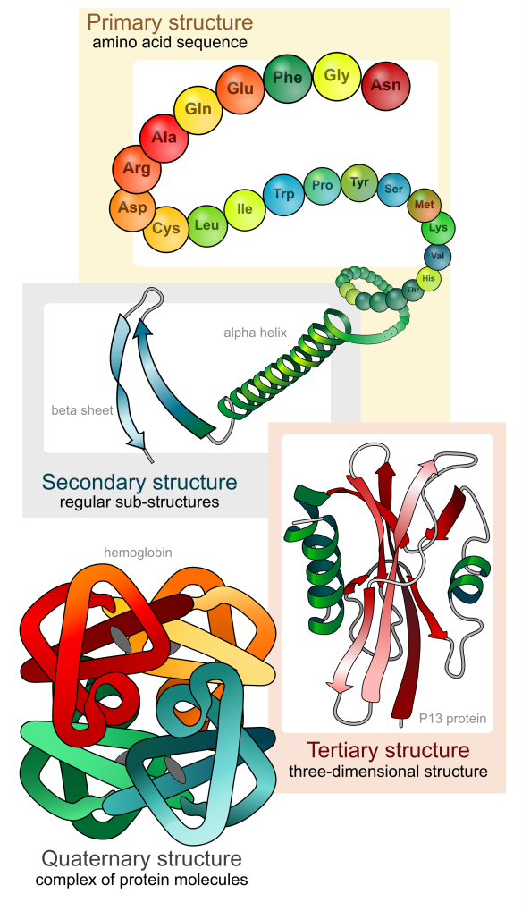
Proteins : Bio Macromolecules
Proteins are essential for the main physiological processes of life and perform functions in every system of the human body.
Examples of proteins in our body:
keratin- hair, nails
Enzymes
Hormones
Actin and myosin- muscles
Haemoglobin
Antibodies
The list is bigger….

Slide 20
Proteins are composed of amino acid subunits that form polypeptide chains.
Each protein has its own number and sequence of amino acids. This gives each protein molecule a particular shape, allowing it to carry out a particular function.

Slide 21
Formation of Polypeptides
Amino acid monomers joined together in a condensation reaction to form a polyamide.
The polyamide chain is folded into specific shapes to make proteins that carry out a multitude of jobs including structural support, hormones, enzymes, and balancing chemicals in the body.

Slide 22
Polypeptide chain
The link between amino acids is called a peptide link and is the same as an amide link in a polyamide.
Two amino acids joined together create a dipeptide.
When many amino acids join together, a polypeptide chain is formed.

Slide 23
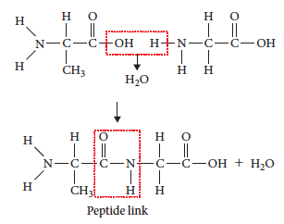
Joining amino acids
To join two amino acids, react the amine end with the carboxylic acid end to form the peptide link.

Slide 24
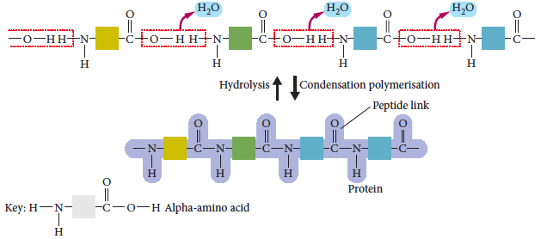
Joining amino acids
The dipeptide continues to join to other amino acids via the functional groups at either end of the molecule.

Slide 25
Protein Structure
To be able to perform their biological function, proteins fold into specific spatial conformations.
The formation of binding pockets and 3D structures allow proteins to create different chemical environments through which they can specifically interact with other bio-macromolecules, small molecules or water.

Slide 26
Protein Structure
The most important of features of a protein that enable it to perform its specific biological functions include the:
Nature and sequence of amino acids that make up the polymer and give the primary structure.
Way the polymer is arranged within segments to give secondary structure.
Way the secondary structure is arranged to give the whole molecule its tertiary and quaternary structure.
Primary Structure
Secondary Structure
Tertiary Structure
Quaternary Structure
These structures determine the properties and biological functions

Slide 27
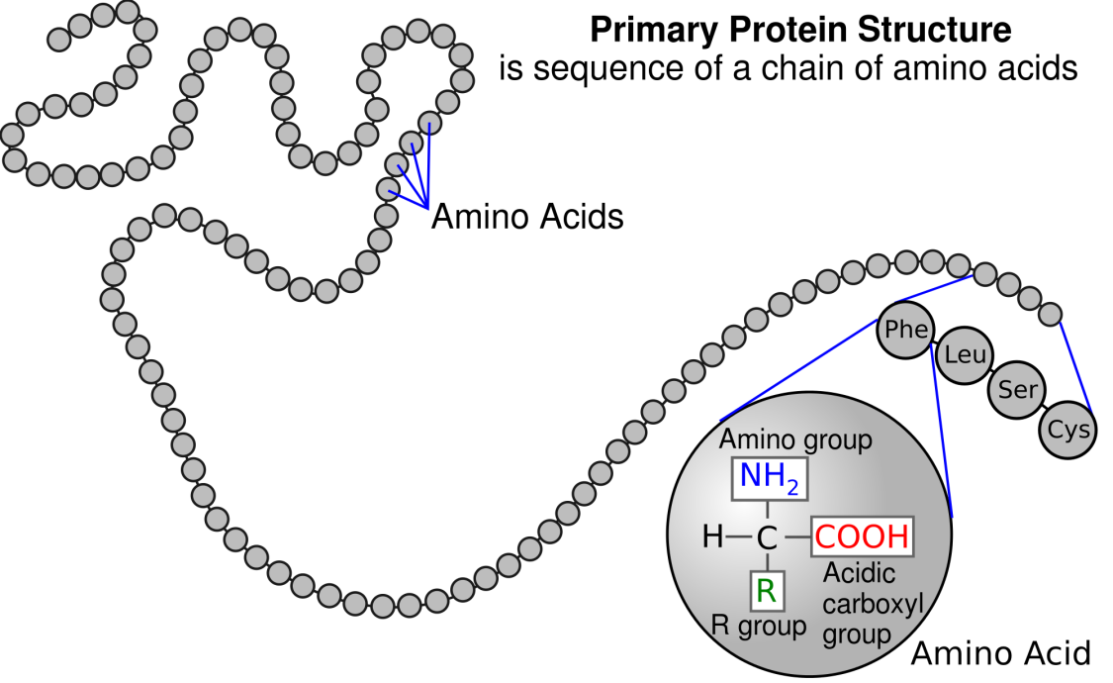
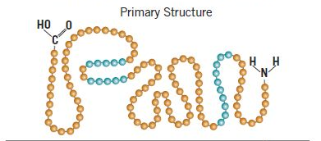
Primary structure
The unique sequence of amino acids that makes up a protein or polypeptide chain.

Slide 28
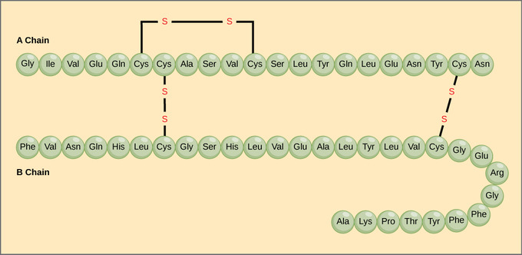
the pancreatic hormone insulin has two polypeptide chains, A and B.

Slide 29
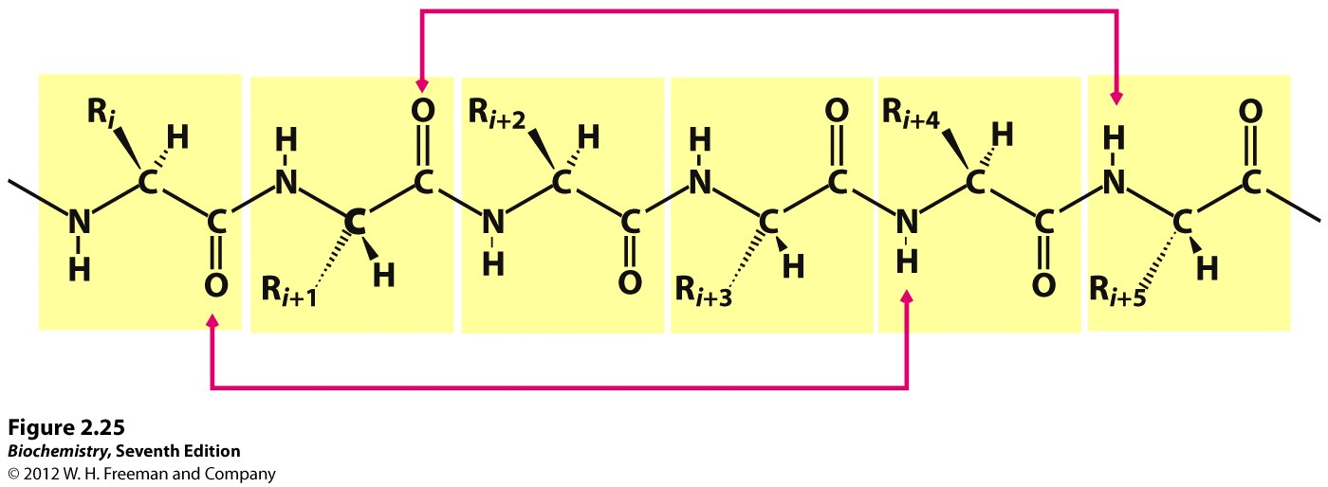
Secondary Structure
The way in which the primary structure of a polypeptide chain folds.
Two common examples of secondary structures are Alpha Helices and Beta Pleated Sheets. Secondary structure is held together by many Hydrogen bonds, overall giving the shape great stability.

Slide 30
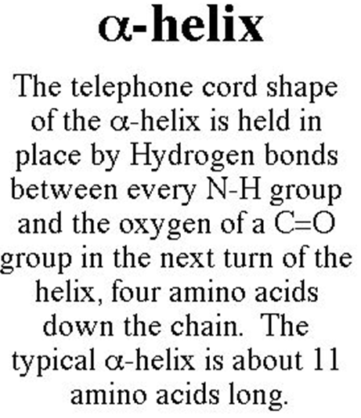
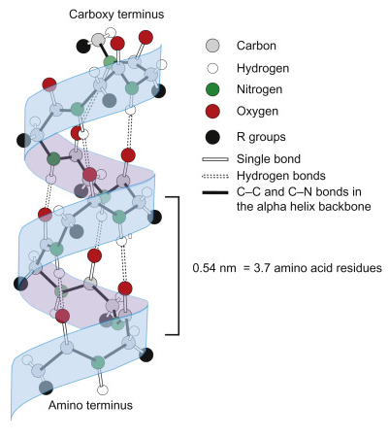
Hydrogen bonds form between the oxygen of the C=O of each peptide bond in the strand and the hydrogen of the N-H group of the peptide bond four amino acids below it in the helix.

Slide 31
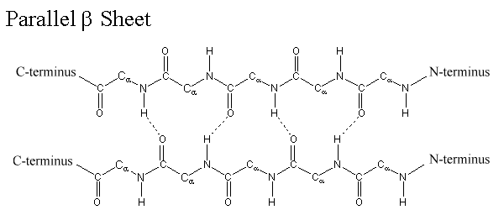
ß Sheets
The hydrogen bonding in a ß-sheet is between strands (inter-strand) rather than within strands (intra-strand).
The sheet conformation consists of pairs of strands lying side-by-side.
The carbonyl oxygens in one strand hydrogen bond with the amino hydrogens of the adjacent strand.

Slide 32
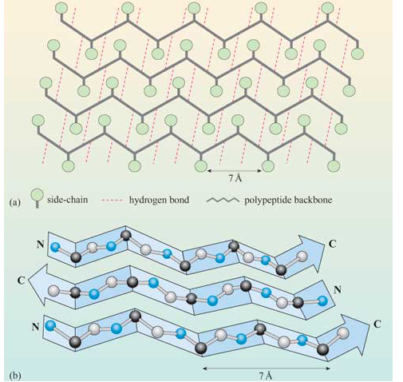
Beta Sheets

Slide 33
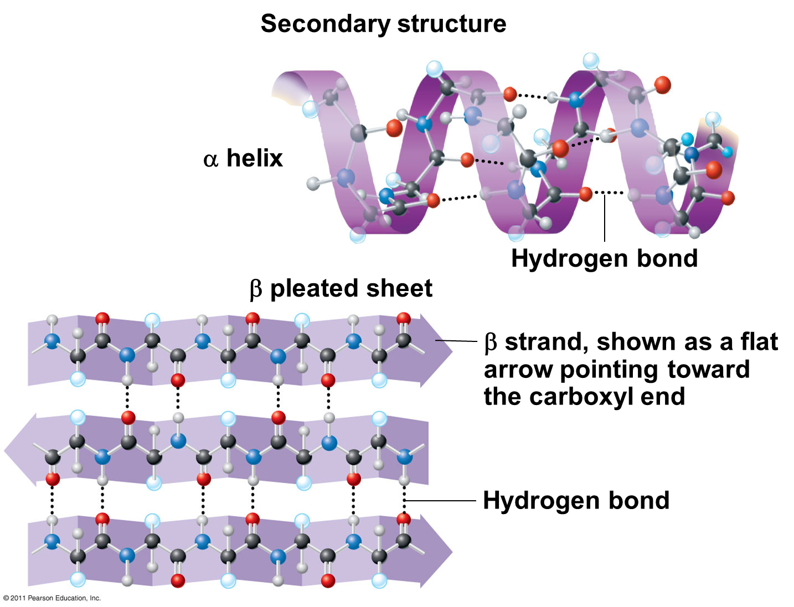

Slide 34
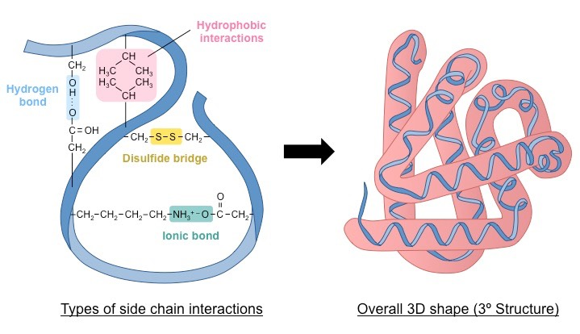
Tertiary structure
The tertiary structure of a protein is a description of the way the whole chain (including the secondary structures) folds itself into its final 3-dimensional shape.
Most important level of organisation.
Examples- keratin/ collagen, spherical globules like insulin, enzymes.

Slide 35
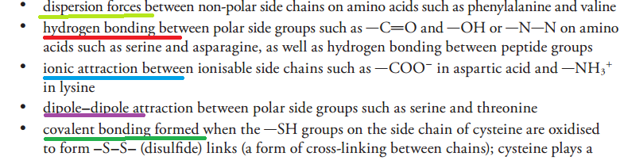
Interactions in Tertiary structure

Slide 36
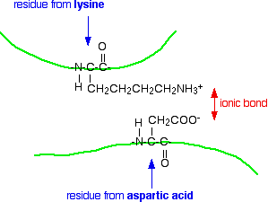
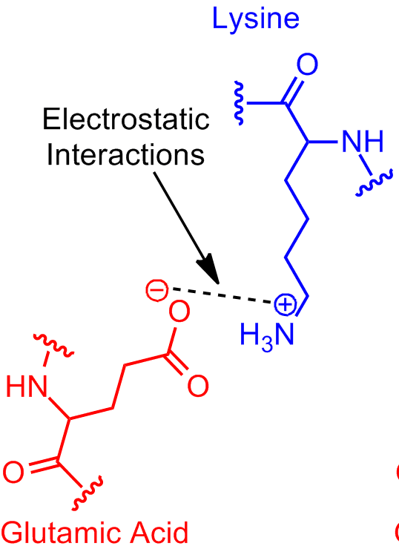
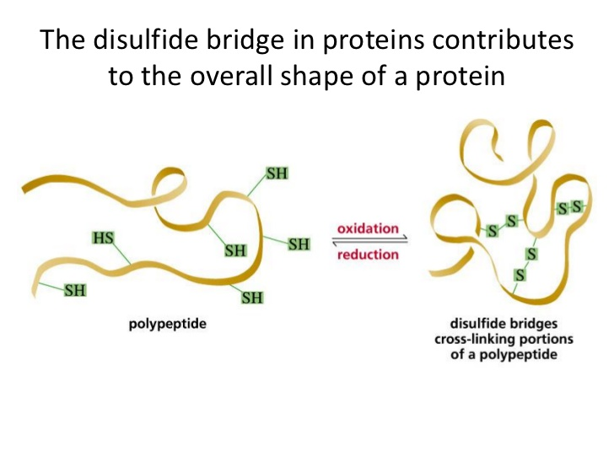
Salt bridges and disulphide bridges

Slide 37
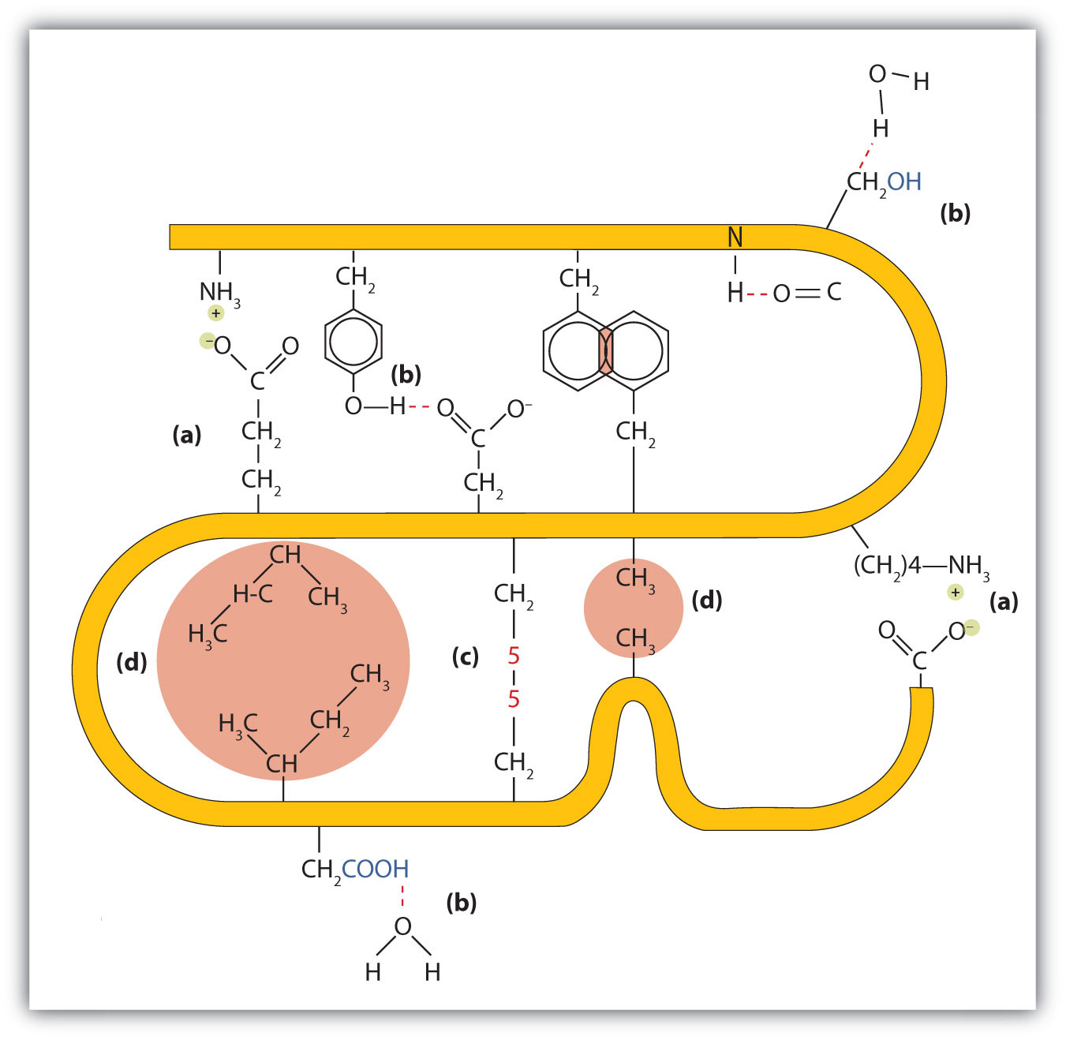
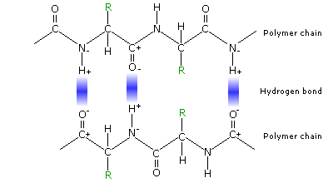
Dispersion forces and H-bonding

Slide 38
TERTIARY STRUCTURE

Slide 39
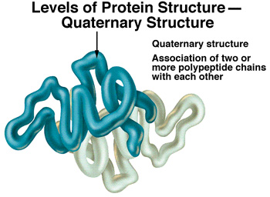
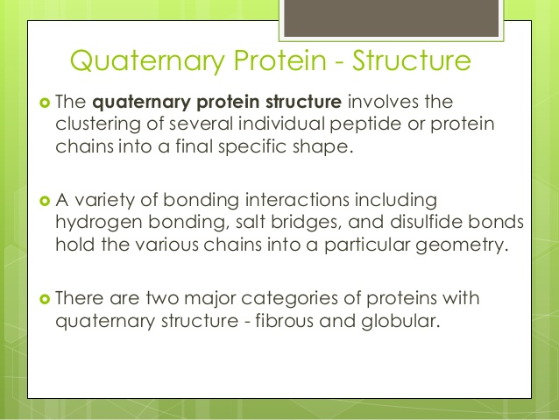
Quaternary structure

Slide 40
Enzymes-Bio catalysts
Enzymes are biological catalysts - catalysts are substances that increase the rate of chemical reactions without being used up. Enzymes are also proteins that are folded into complex shapes that allow smaller molecules to fit into them. The place where these substrate molecules fit is called the active site.

Slide 41
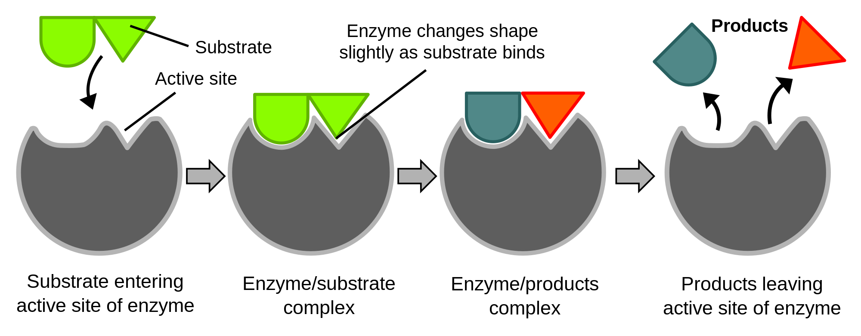
Enzymes action

Slide 42
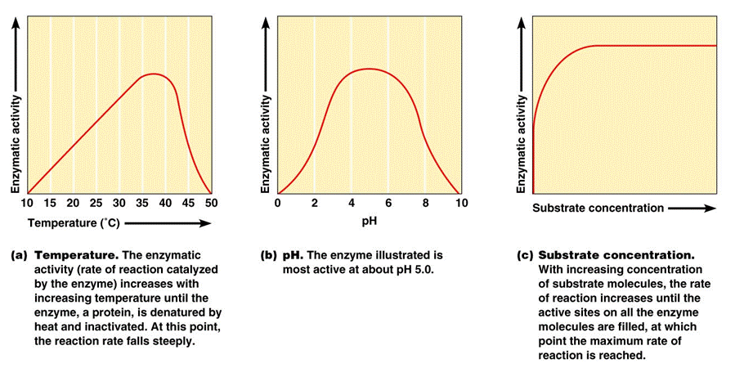
Factors affecting enzyme action

Slide 43
